Slide 1
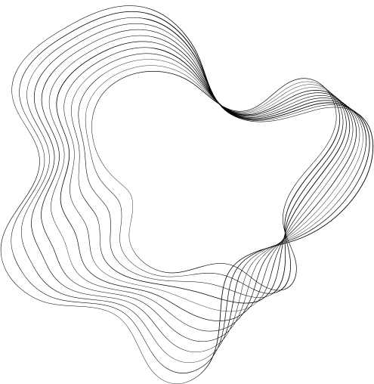

ANALYZING EMS
RESPONSE TIME

Slide 2
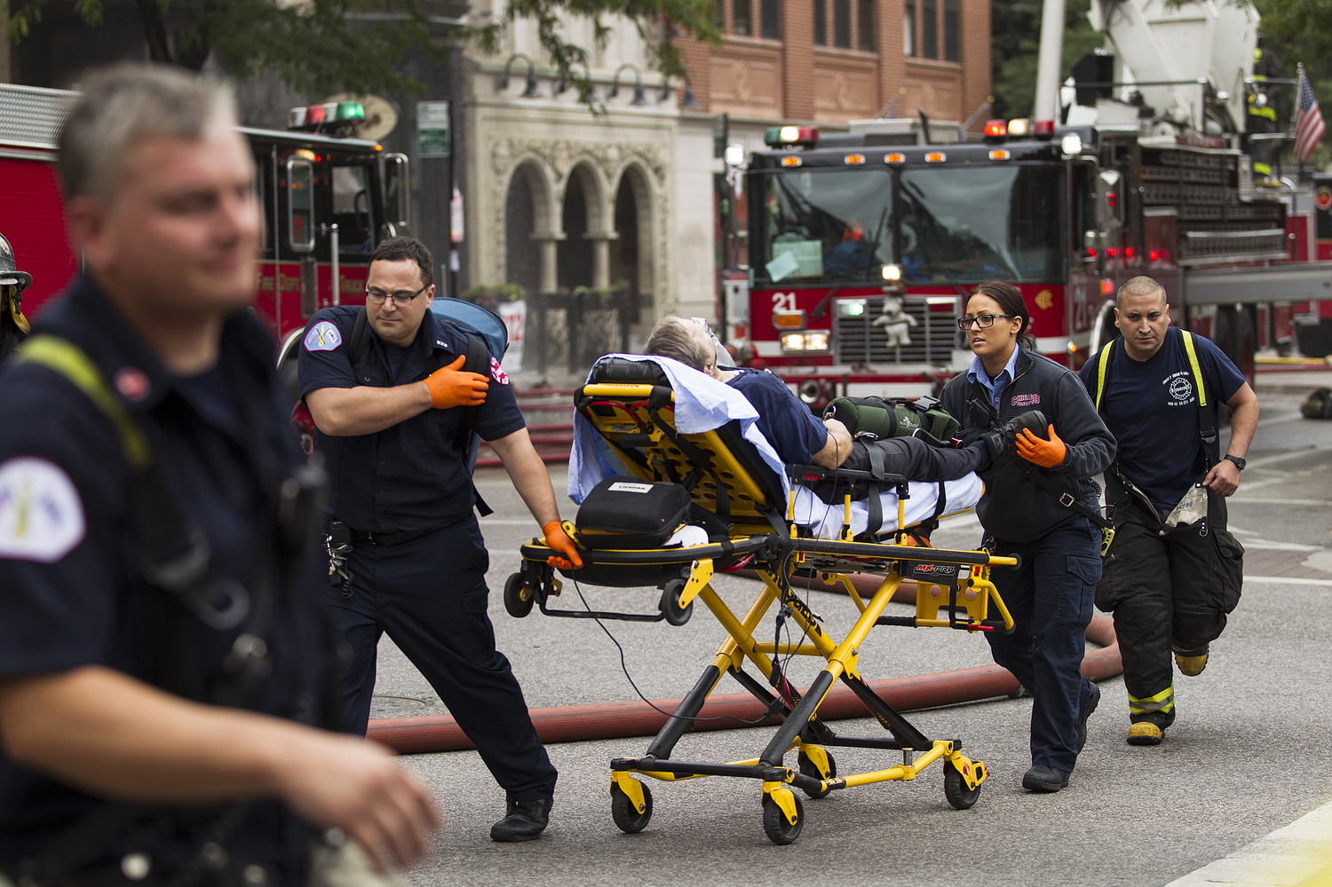


INTRODUCTION
EMS stands for Emergency Medical Services, a system providing immediate medical care in emergencies.
Analyzing EMS incident dispatch data allows us to understand response patterns, assess service efficiency, and identify areas for improvement.
It contains records of EMS incidents, including dispatch times, incident types, locations, and units dispatched.

Slide 3
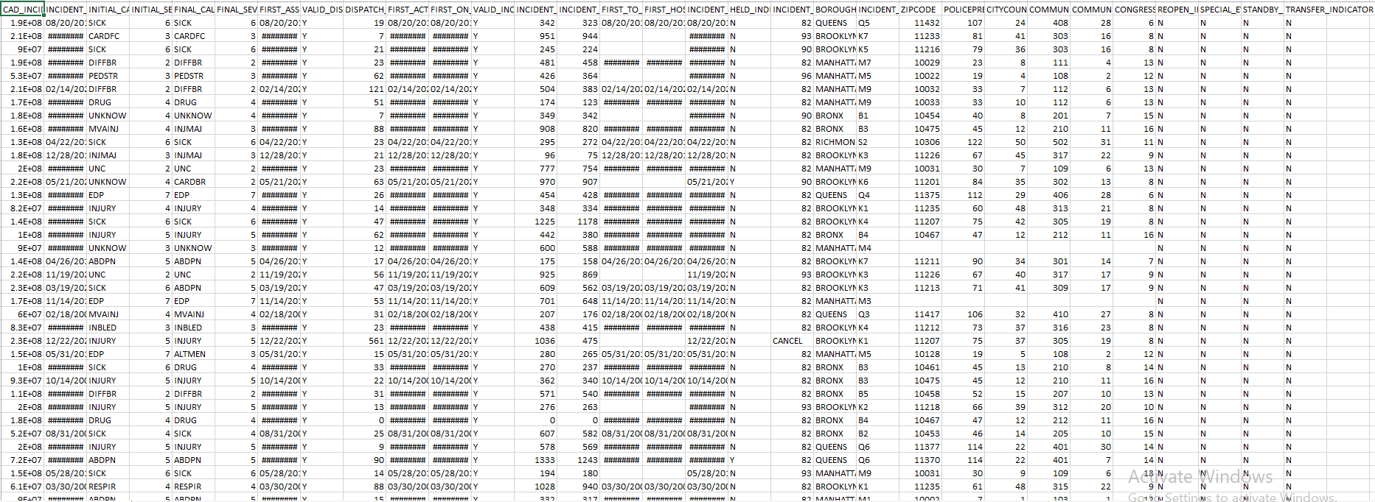
DATASET

Slide 4
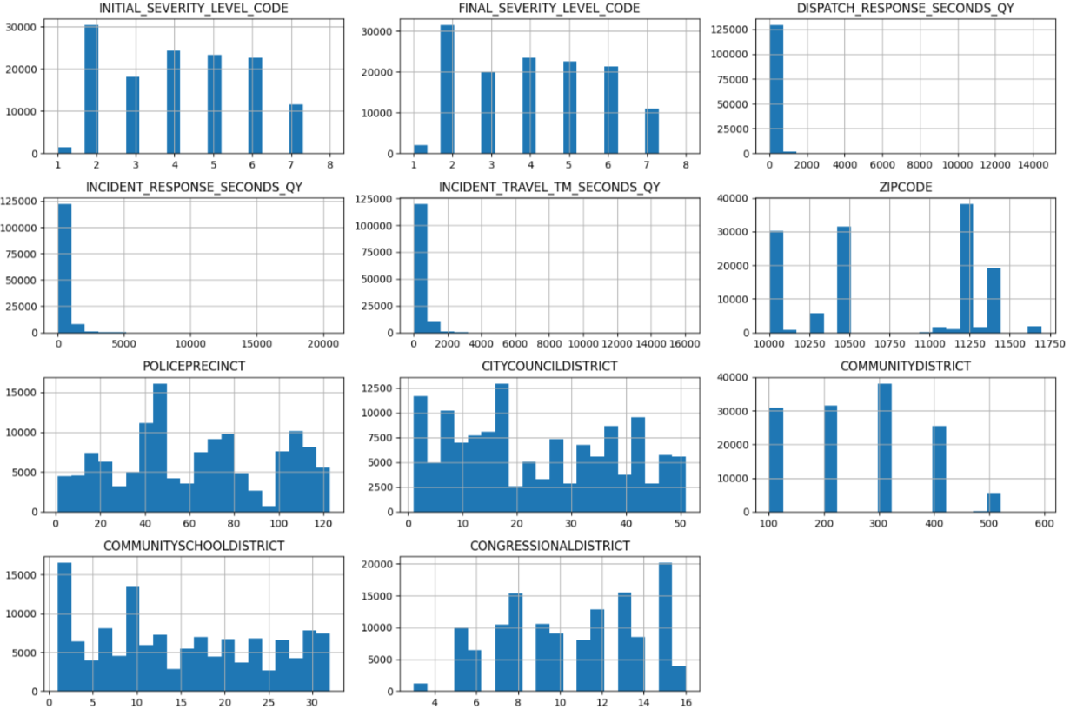
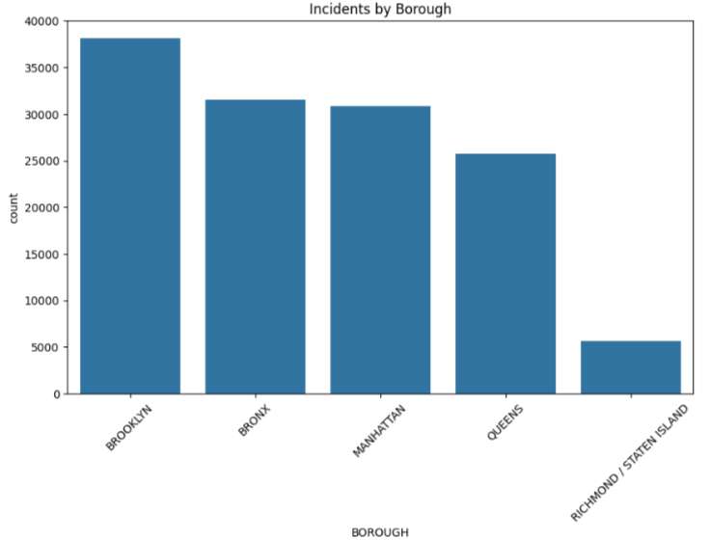
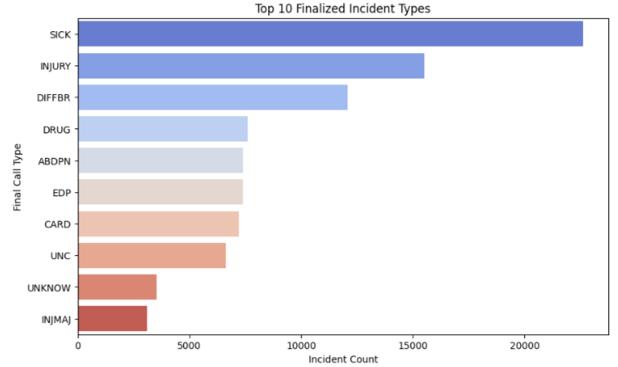
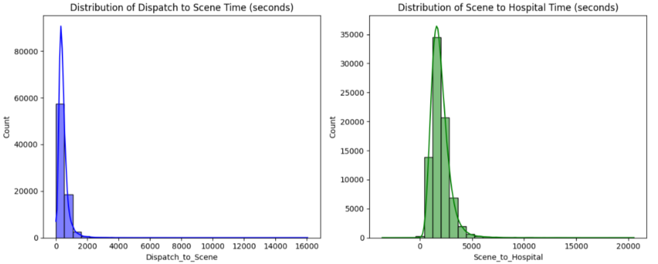
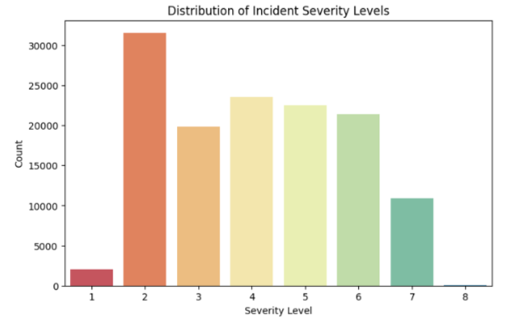
DISTRIBUTIONS OF NUMERICAL COLUMNS

Slide 5
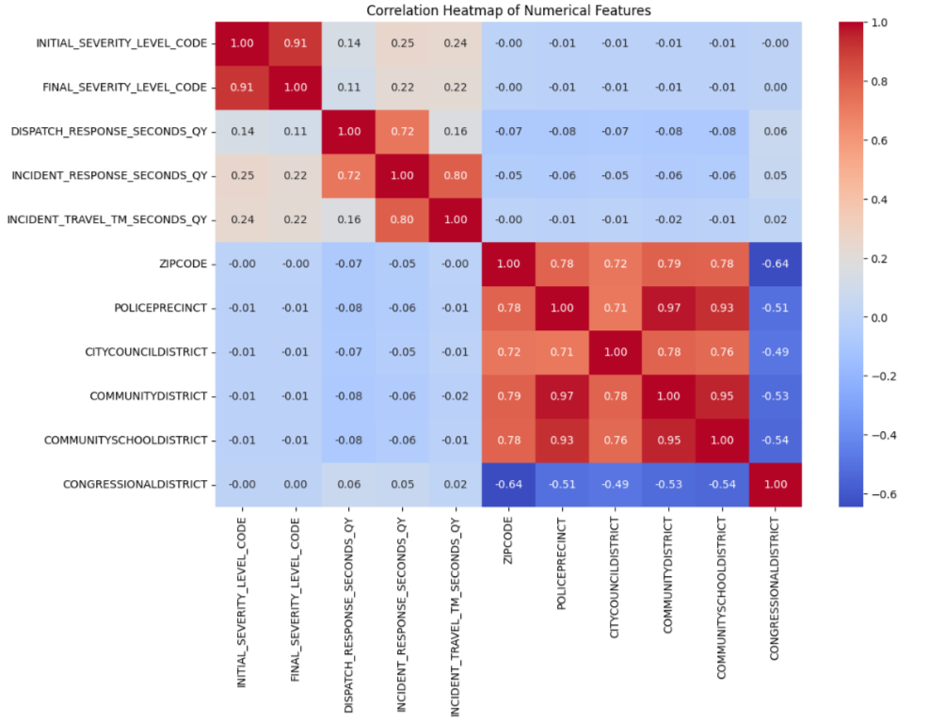
CORRELATION HEATMAP

Slide 6
FREQUENCY DISTRIBUTION OF RESPONSE TIMES

Slide 7
GEOGRAPHICAL ANALYSIS

Slide 8
TOP 10 DIFFERENT INCIDENT TYPES

Slide 9
SEVERITY DISTRIBUTION FOR THE ENTIRE DATASET

Slide 10
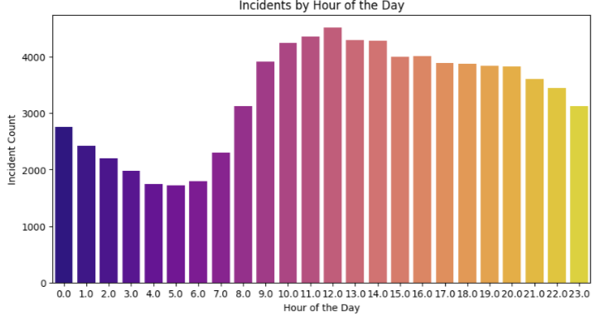
TEMPORAL PATTERNS

Slide 11
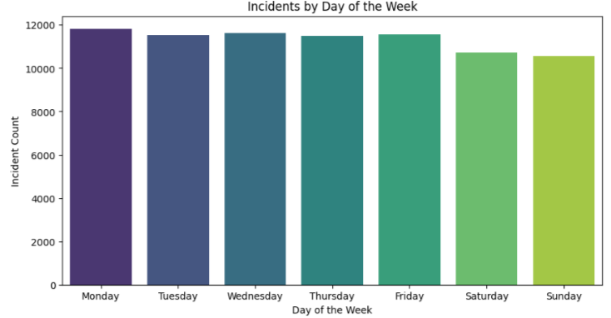
TEMPORAL PATTERNS

Slide 12
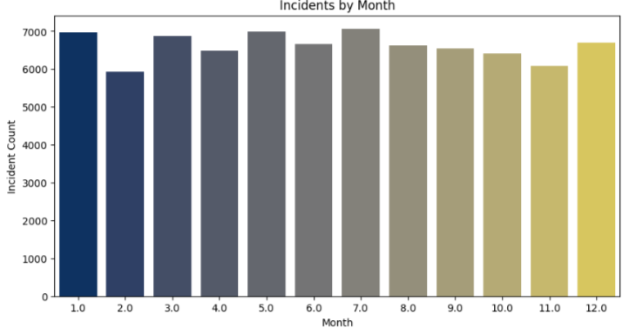
TEMPORAL PATTERNS

Slide 13
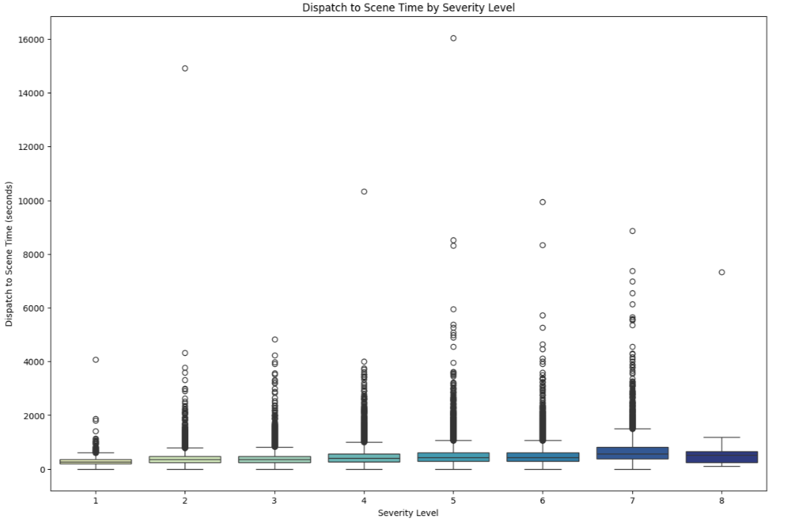
EXAMINE IF HIGHER-SEVERITY INCIDENTS TEND TO HAVE QUICKER RESPONSE TIMES

Slide 14
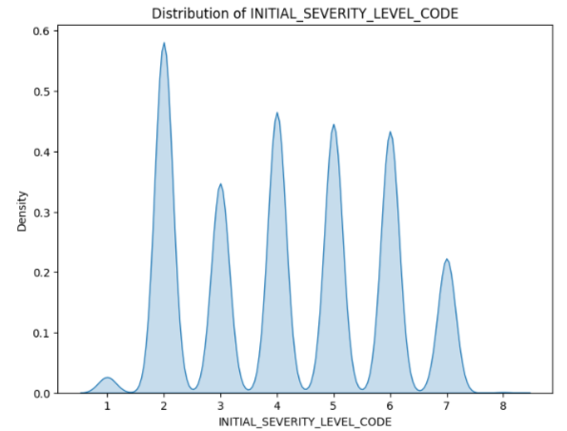
Kernel Density Estimation (KDE) Plot

Slide 15
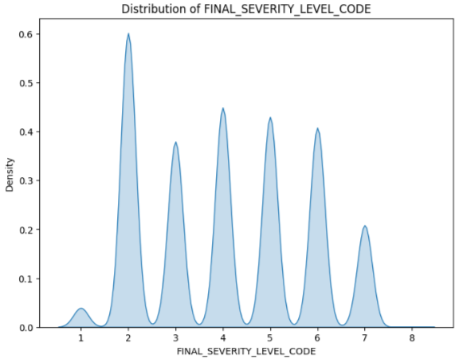
Kernel Density Estimation (KDE) Plot

Slide 16
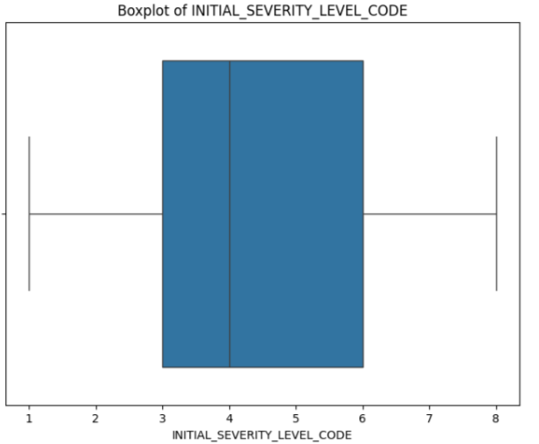
Boxplots for Outlier Detection

Slide 17
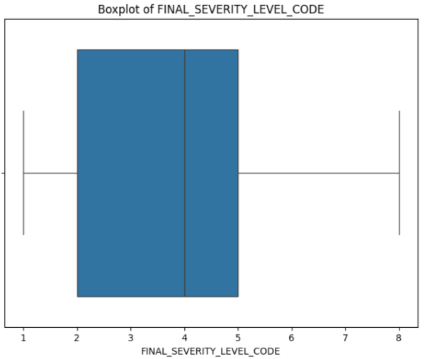
Boxplots for Outlier Detection

Slide 18
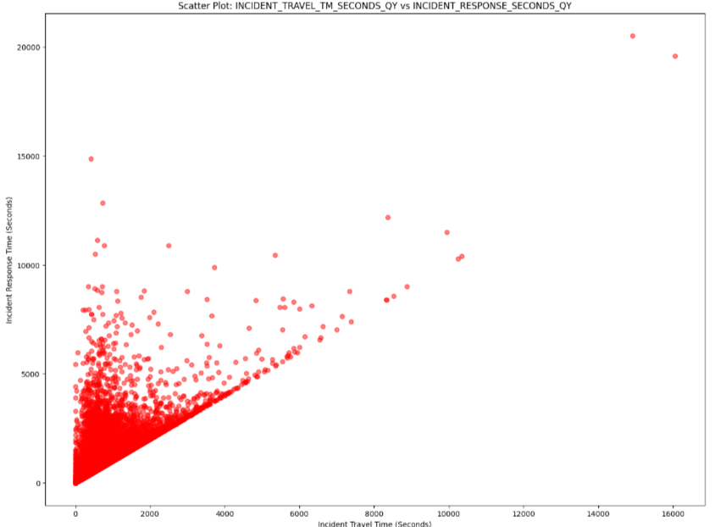
Scatter Plot for Continuous Variables

Slide 19
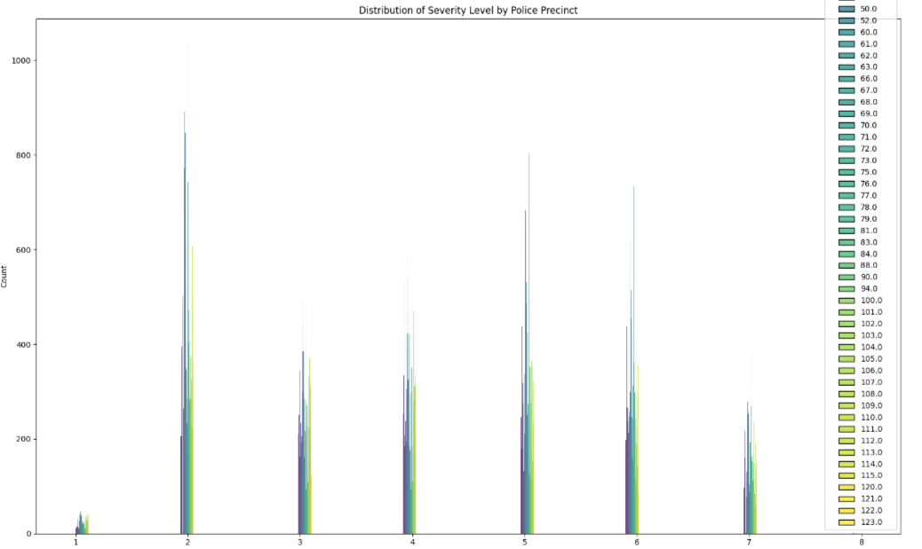
HISTOGRAM OF FINAL_SEVERITY_LEVEL_CODE
BY POLICEPRECINCT

Slide 20
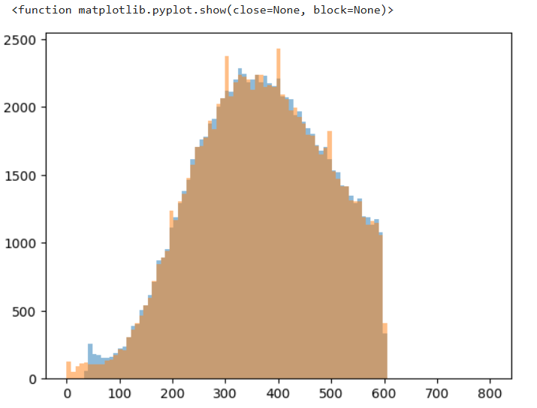
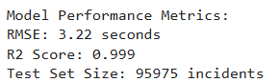

Slide 21

THANK YOU
ROSHAN NIRANJAN KALPAVRUKSHA
TEJOMAY K
KAMALAESH KATARI
VINDYASREE KANCHI

